Slide 1
MCAS Grades 3-8 Computer-Based Testing Pre-Administration Tasks for Technology Staff
February 9, 2017
This session will start at approximately 1:00PM and will be recorded and available with 24 hours of the conclusion by emailing mcas@doe.mass.edu.

Slide 2
Presenters
Bridgette Kelly
Educational Specialist at DESE
LeAnn Dahn
Project Manager for Pearson
Ammar Alim
Field Engineer for Pearson

Slide 3
Agenda
Review of Computer-Based Testing Components
TestNav Installation
ProctorCache
Infrastructure Trials
Troubleshooting
Resources and Support

Slide 4
Computer-Based Testing Components
PearsonAccess Next
Online test management system for principals, test coordinators, and technology coordinators to manage user accounts, student registration, and computer-based test sessions.
TestNav8
Online testing platform used by students to take the computer-based MCAS assessments
ProctorCache
Software that allows for precaching of test content on a designated proctor caching machine located at the school or district. Strongly recommended in order to reduce bandwidth requirements and provide a more seamless testing experience for students.

Slide 5
TestNav Installation

Slide 6
TestNav Introduction
Test content will be delivered to TestNav via the proctor caching server and accessed with a student testing ticket printed out from PearsonAccess Next.
TestNav must be installed on all devices that will be used for testing.
If testing on a desktop or laptop computer, the Department strongly recommends the use of the TestNav desktop application.

Slide 7
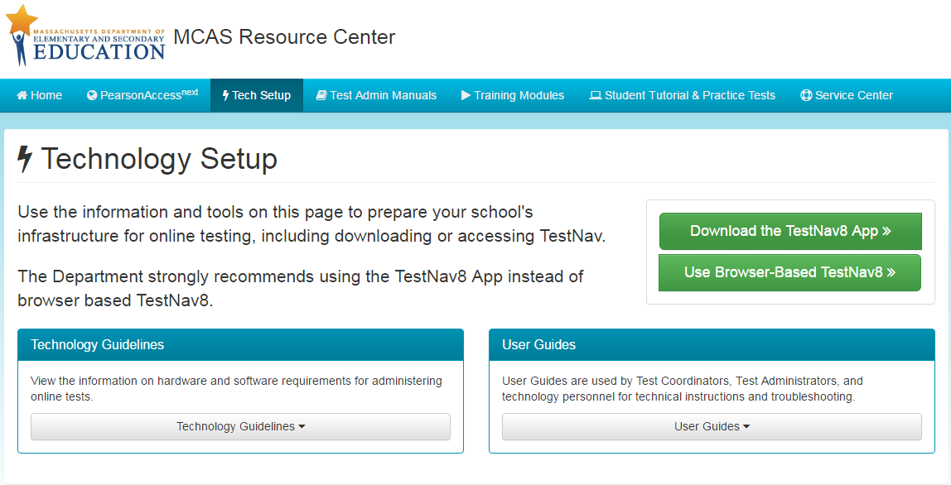
TestNav Download
mcas.pearsonsupport.com/technology-setup
Tech staff should review the hardware requirements before downloading TestNav

Slide 8
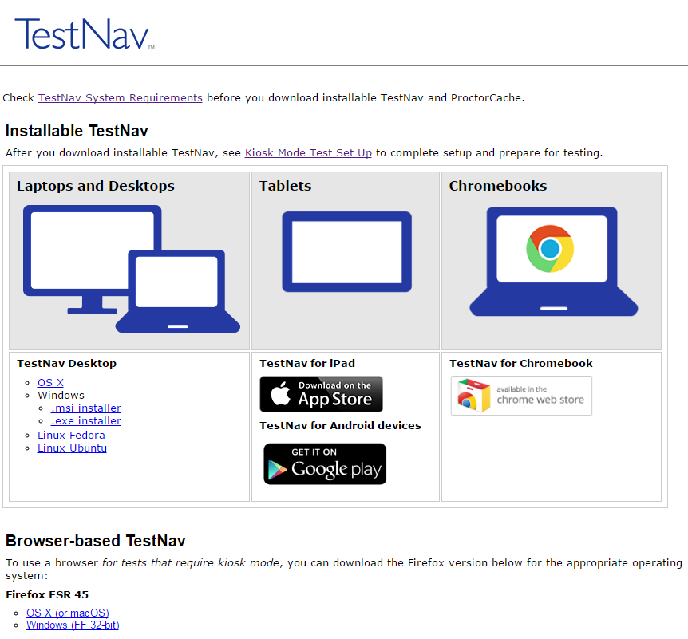
TestNav Download
Each available platform has a TestNav app available for download here.
Ensure that you are downloading the correct app for your device.
Students using Screen Reader or AT forms must use the browser-based TestNav.
Firefox ESR 45 is the only browser that can be used.
Notes:
If your school is downloading the TestNav 8 app, it’s accessible at download.testnav.com.
Based on the platform that you will be using – Desktop or laptop, iPad, or Chromebook - download the app or apps that you’ll need for testing. We’ll talk more about iPads and Chromebooks shortly.
If you’re installing TestNav for Desktop, there are options for Mac, Windows, and Linux.
There are two options for Microsoft Window: .msi and .exe.
The .msi file is optimized for network installation as a group and pushing out to multiple computers.
The .exe file is for downloading onto individual computers.
There is a .dmg file for installing on Macs.
In general, the Desktop installation only takes a few minutes on an individual computer; network installations will vary depending on your environment.
[CLICK] Please note the link on this page to TestNav System Requirements. The information on the next several slides all comes from that link, so you can review it later.

Slide 9
Network Configuration
Firewalls, content filters, spam filters, and any other routing or blocking systems should be set to allow access to the following:
.testnav.com: 80
.testnav.com: 443
.pearsontestcontent.com
.thawte.com
.usertrust.com
.comodoca.com
.google-analytics.com (optional)
Notes:
Before you begin, firewalls and other filtering systems will need to be set to allow a small number of sites. This list can be reached by clicking “TestNav System Requirements” from download.testnav.com

Slide 10
Windows, OS X, and Linux Requirements for TestNav App
Supported Operating Systems
Windows: 7, 8.1, 10
OS X: 10.9, 10.10, 10.11
Linux Fedora 24 (64-bit); Ubuntu 16.04 (64-bit)
Requirements | Windows | OS X | Linux
Supported devices | Desktops Laptops Tablets | Desktops Laptops | Desktops Laptops
Processor | x86/x32 and x64 | Intel-based | x86/x32 and x64
Memory | Recommended: 1GB RAM Minimum: 512MB RAM | Recommended: 2GB RAM Minimum: 1GB RAM | Recommended: 2GB RAM Minimum: 1GB RAM
Min. Screen Size | 9.5 in. | 9.5 in. | 9.5 in.
Min. Screen Resolution | 1024 x 768 | 1024 x 768 | 1024 x 768
Notes:
The installable TestNav app has a few minimum technology requirements. We’ll cover Windows, Mac OS X, and Linux now, and then discuss Chromebooks, iPads, and Android devices separately.
Mac OSX and Windows are supported; (Mac OS X 10.9–10.11 and Windows 7–Windows 10).
Linux is supported on Fedora 24 and Ubuntu 16.04.

Slide 11
Chromebook System Requirements for TestNav App
Chromebooks require Chrome OS 50-55
Required to use TestNav app
 | Chrome OS
Supported devices | Chromebooks
Processor | Any
Memory | Recommended: 4GB RAM Minimum: 2GB RAM
Min. Screen Size | 9.5 in.
Min. Screen Resolution | 1024 x 768
Notes:
For the Chromebooks it’s important to note some highlights:
Minimum and recommended memory requirements are listed here
And they require Chrome OS 50 and above
There are no Java or browser requirements for Chromebooks, as students will use the TestNav 8 App to access their test content.
And while Chromebooks can take advantage of a ProctorCache setup, allowing TestNav to gather cached content, they can’t be used as the actual ProctorCache machine itself.

Slide 12
Chromebook Setup Overview
Two setup methods
Managed Chromebooks
Can be performed simultaneously on all Chromebooks in your domain
Two main steps to complete:
Unmanaged Chromebooks
Steps have to be performed on each Chromebook
Requires access to the administrator/owner account for the device
Install TestNav app and set it to run as a Kiosk app
Preserve local data on Chromebook to retain student response files (SRF) and log files on the device
Device will be backed up to cloud storage and deleted if you do not have access to the administrator account for the device
Notes:
Now let’s move into the setup details. As we mentioned before, Chromebooks can either be managed or unmanaged, which presents us with two different setup methods.
[CLICK] For managed devices, all of the setup steps will be performed through the central administration, so all Chromebooks in a domain can be configured at once. When using managed devices, there are two main steps you’ll need to complete – install the TestNav 8 App and set it to run as a Kiosk App, and preserve the local data on the Chromebook to retain Saved Response File (SRF) and log files on the device.
[CLICK] For unmanaged devices, the setup steps will have to be performed on each device individually. This requires access to the administrator account for the device. If you don’t have access to the administrator account, the Chromebook will need to be backed up to cloud storage and wiped clean before you can continue. After testing, it can be restored from the cloud.

Slide 13
Saved Response File (SRF) on Tablets and Chromebooks
Primary saved response file location is managed by the TestNav app
Pearson recommends secondary save location using an SFTP address to ensure all devices have a backup save location
Steps and instructions to find SRF and log files on the TestNav system requirements page at https://support.assessment.pearson.com/display/TN/Find+SRF+and+Log+Files
Notes:
With TestNav Desktop and browser-based TestNav, the primary save location for Saved Response File (SRF) and TestNav log files is managed by your TestNav Configuration in PearsonAccess Next, which we’ll examine in a few minutes. With tablets and Chromebooks, the primary location is hardware storage space that is reserved and managed by the TestNav 8 app. Pearson recommends using an SFTP address for the secondary save location to ensure all devices have a backup save location. Non-SFTP addresses will only be used by TestNav Desktop and browser-based testing.
The Pearson Support site provides steps and instructions to assist you, should you need to locate the SRF and log files on any student testing computer. This can be found from the TestNav System Requirements page.

Slide 14
iPad System Requirements for TestNav App
iOS9.3.2 – 9.3.5, 10.2 and 10.2.1 are supported
iOS10 is not supported at this time, iPads using iOS10 will need to upgrade to at least iOS10.2.
 | iOS
Supported devices | iPads
Processor | Any
Memory | Recommended: 1GB RAM (iPad 3rd gen +) Minimum: 512MB RAM (iPad 2)
Min. Screen Size | 9.5 in.
Min. Screen Resolution | 1024 x 768
Notes:
Let’s have a look at the system requirements for iPads. It’s important to note some highlights for the iPad:
Minimum and recommended memory requirements are listed here
And your iPad Requires iOS 9.3.2 - 9.3.5, 10.2, and 10.2.1 . As with Mac OS 10.12 Sierra, iOS 10 is not supported at this time
And while iPads can take advantage of a ProctorCache setup, allowing TestNav to gather cached content, they can’t be used as the actual ProctorCache machine itsel

Slide 15
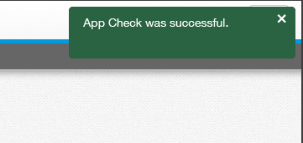
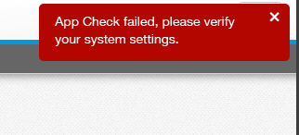
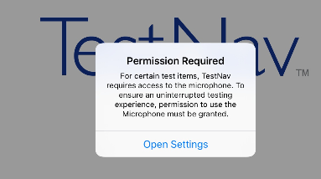
SetUp TestNav on iPad
Install TestNav app
Run App Check
Confirm App Self Lock
Passing systems display
Failing systems display
Start the TestNav app
The first time TestNav is launched, it displays the Enable Microphone Permission message.
Tape or click Yes to grant microphone permission.
If the student taps or clicks No, TestNav displays another prompt.
Notes:
Now let’s move into the setup details.
Download TestNav for iPads from the AppStore
To run App Check, on each device: Click or tap the appropriate icon for your test from the home page, if you haven’t done so already.
Click or tap the user drop-down menu, and select App Check.
On the Confirm App Self Lock message, click or tap Yes to continue.
Passing systems display a green success message at the top-right of the page.
Failing systems display a red failure message at the top-right of the page.
When you’re ready to start a test, note that the first time TestNav is launched, it displays the Enable Microphone Permission message.
Tap or click Yes to grant microphone permission.
If the student taps or clicks No, TestNav displays another prompt, shown here.
Start a test to ensure that you can do so without error.
There is a Practice Tests link on the Sign in page, click Practice Tests and start a test.
When starting a test that requires kiosk mode, the student should:
Enter a username and password, and tap or click Sign In.
On the Confirm App Self Lock message, click or tap Yes to continue testing.
Students that click or tap no, cannot continue testing in the secure test.

Slide 16
Android Device Requirements for TestNav App
Operating system requirements: Android 5.0 – 7.0
 | Android
Supported devices | Tablets
Processor | Any
Memory | Recommended: 2GB RAM Minimum: 1GB RAM
Min. Screen Size | 9.5 in.
Min. Screen Resolution | 1024 x 768
Notes:
Let’s have a look at the system requirements for Androids. It’s important to note some highlights:
Such as Minimum and recommended memory requirements
Requires Android 5.0 or higher
There are no Java or browser requirements for Android devices, as students will use the TestNav 8 App to access their test content.
And while Android devices can take advantage of a ProctorCache setup, allowing TestNav to gather cached content, they can’t be used as the actual ProctorCache machine itself.

Slide 17
Android Devices Setup Overview
Two setup methods
Google Play for Education
Install app using your Google Play for Education account
Mobile Device Manager (MDM)
TestNav app can be installed using an MDM that supports Device Owner
Add names or email address of those users you want to access TestNav
Google tips: https://support.google.com/ edu/play/answer/3433713
Afasfasf
Asfasfaf
Install using Google Play store
Enter TestNav in the search field
Select TestNav and select Install
When launching TestNav, it will display the Screen Pin dialog. Tap Yes, Tap Start Test Now.
Can also use Google Group or contact group
Unmanaged Devices
Notes:
Now let’s move into the setup details. Android devices can be installed with a Google Play for Education account, or by using a mobile device manager that supports Device Owner.
[CLICK] To install on Android devices, you can use your Google Play for Education account to download the app. You’ll need to add the names or email addresses of those you want to access the TestNav app; alternatively, you can use Google Group addresses or a contact group. You can find tips for sending content to students on the Google support site.
[CLICK] You also have the ability to install the TestNav app using a mobile device management (or MDM) system that supports Device Owner.
You can install TestNav on unmanaged Android devices through the Google Play store App….

Slide 18
ProctorCache

Slide 19
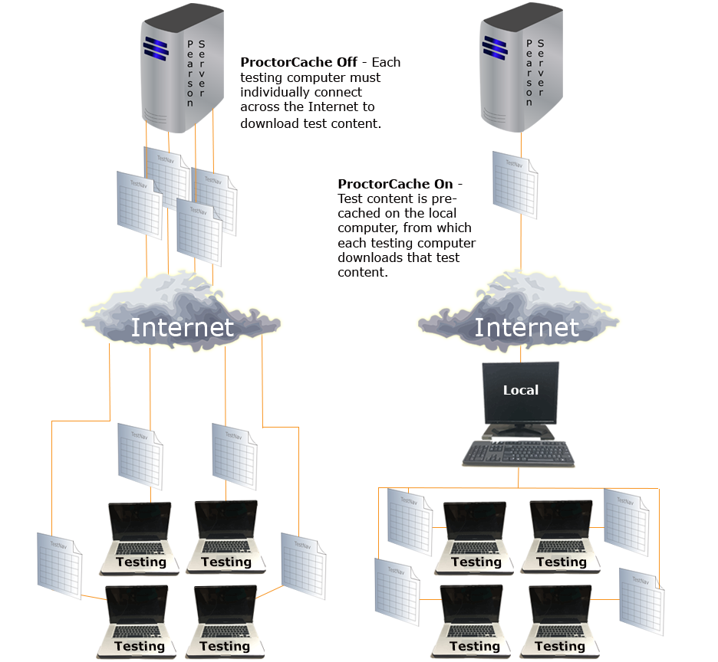
What is Proctor Caching?
ProctorCache is Pearson software that:
Allows you to precache test content to your local network before a test;
Reduces the burden on your network bandwidth
Proctor caching is strongly recommended for all organizations testing online
Notes:
ProctorCache is Pearson-supplied software that’s used in conjunction with TestNav to reduce bandwidth requirements and accelerate the delivery of test content.
So what can you do with ProctorCache?
You can pre-cache content before the test to your local network
You can reduce or eliminate redundant downloads of test content, which will reduce the burden on your internet service provider (ISP)
And you can store an encrypted local copy of all pre-cached tests and serve them at LAN speeds to students.
Proctor caching is highly recommended due to the many benefits it provides.
This diagram illustrates two network scenarios.
The scenario on the left illustrates a network setup that doesn’t use proctor caching. Each student is downloading a unique copy of the test content directly from the Pearson servers. The diagram shows that redundant test copies are being downloaded simultaneously over the corporation’s ISP connection, while students are waiting to test. This heavy use of bandwidth not only affects how quickly the test loads for students, but also the available bandwidth for all other internet-related activities.
The right side of the diagram shows the network traffic for a test environment successfully using proctor caching. The test content is pre-cached once in an encrypted format to a local workstation designated in the TestNav configuration setup as the proctor caching computer. Students that are assigned to the proctor caching computer will locally access the test content without utilizing your internet bandwidth, thus decreasing overall network traffic for your corporation. The closer the configured computers are to the proctor caching workstation, the faster the delivery of content.
corporations have the flexibility to decide where to implement proctor caching in the network environment. Based on local network considerations, corporations can implement proctor caching machines at the corporation or school-level. If implementing at a corporation-level, we recommend considering the added complexity of the connection between the school and the central location. If proctor caching computers are housed at the school where students are testing, then you don’t have to worry about an outside connection.
Without ProctorCache, each testing computer must individually connect across the Internet to download test content.
With ProctorCache, test content is mirrored on a local computer from which the testing computers download test content.

Slide 20
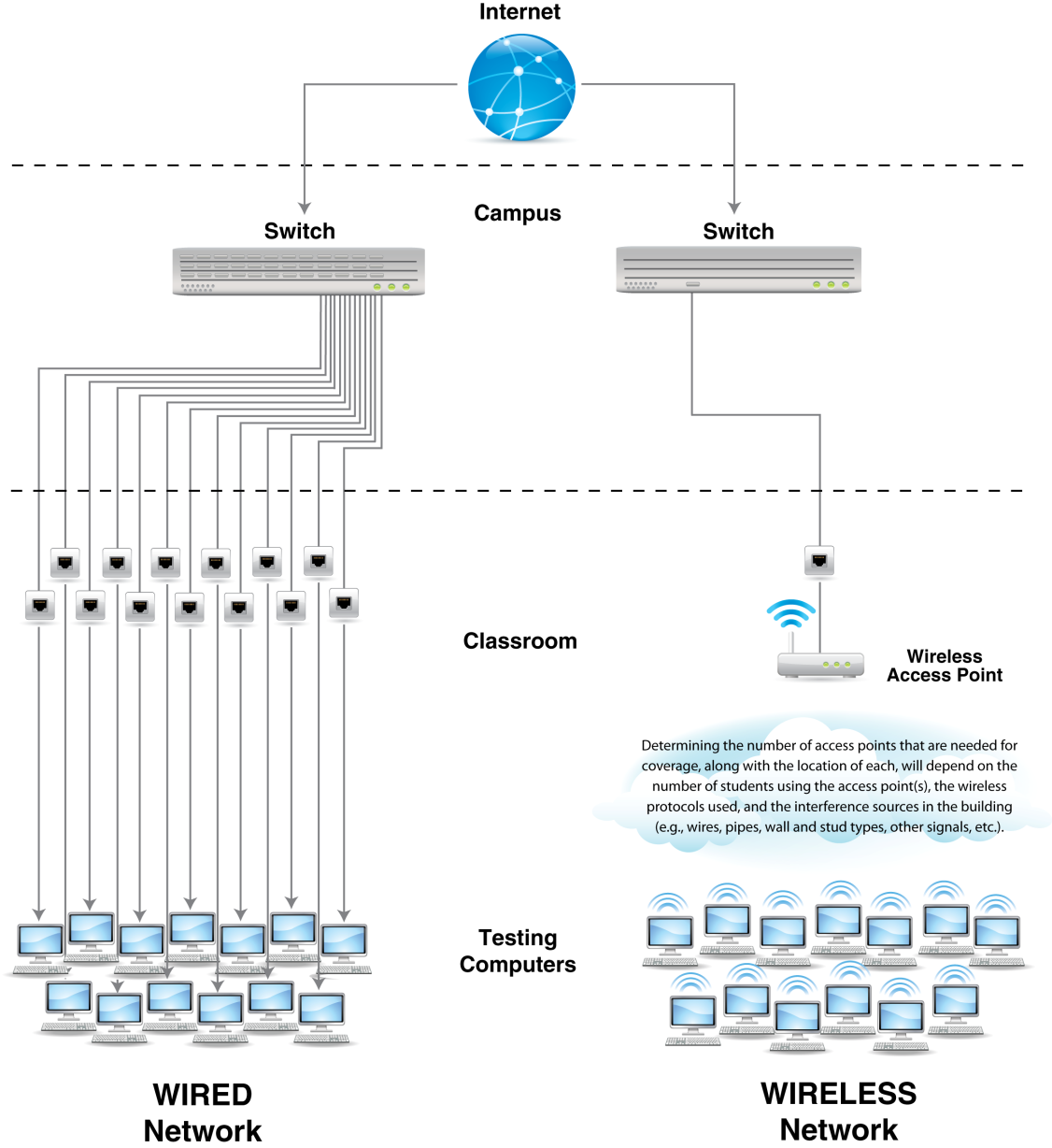
Internet Connectivity with Proctor Caching
Wireless access points –
more is better
Limit number of computers per wireless access point
Distance – closer is
better
Limit obstructions
Test performance before scaling
Notes:
Wireless testing is acceptable for computer-based testing. Schools can test both wired and wireless at the same time.
These are some best practices when testing wirelessly:
Ensure sufficient wireless access points and limit the number of computers per wireless access point for better performance.
Computers located closer to wireless access points perform better than those that are farther away.
Obstructions, such as walls and equipment, between testing workstations and wireless access points can disrupt connection and negatively affect performance.
Set up a small number of workstations to measure performance on a wireless network before setting up a large number of workstations.

Slide 21
Proctor Caching System Requirements and Recommendations
Proctor Caching runs on Windows and Mac OS X.
Does not require an underlying server-based operating system.
TCP ports include: 80 (Internet), 443, 4480 and 4481 (Local Network).
Proctor Caching requires a fixed internal IP address.
For setting up an upstream proxy, refer to the Windows or Mac “Set Up and User ProctorCache” section in the TestNav 8 Proctor Caching User Guide.
Organizations may set up multiple proctor caching machines.
Whenever possible, it is recommended to minimize the physical distance between proctor caching machines and student testing devices. It is also recommended to set up proctor caching machines locally (i.e., at schools), rather than centrally (districts).
Notes:
Proctor Caching is the Pearson-supplied software that is used in conjunction with TestNav to reduce bandwidth requirements and accelerate the delivery of test content. The Proctor Caching software is available at http://download.testnav.com/. The Department strongly recommends that all schools administering CBT use proctor caching to deliver test content.
Proctor Caching runs on Windows and Mac OS X. [Macintosh OS X 10.7, 10.8, 10.9, or 10.10 or Windows 7, Windows 8, Windows 10, Windows Server 2008, or Windows Server 2012.]
It does not require an underlying server-based operating system. It can run on desktop class hardware and desktop class operating system, which gives districts flexibility on what machines they use for Proctor Caching. Proctor Caching cannot be run on a Chromebook.
Proctor caching uses TCP Ports 80 and 443 for communication between the proctor caching machine and the Pearson servers, and ports 4480 and 4481 for communication between testing workstations and the proctor caching machine. This means TCP ports 80, 443, 4480, and 4481 must be opened. 80 and 443 are also listed in the URL and ports configuration. You don’t have to perform this step twice. It’s possible to set custom ports for ProctorCache; in this case, those specific ports should be opened and not 4480 and 4481.
Use Assess Testing Capacity in PearsonAccess^{next} found on the “Measure Testing Capacity” page of the PearsonAccess^{next} User Guide test your network capacity before testing online.
Because testing workstations must know a predictable network location for the proctor caching machine, proctor caching requires a fixed internal IP address. Those corporations which require internet traffic to pass through an upstream proxy server will have to configure proctor caching to point to their proxy server. For details on setting up an upstream proxy refer to the “Upstream Proxy Configuration” section in the Proctor Caching User Guide.

Slide 22
Proctor Caching Setup – Download and Installation
Download Installer
Updated ProctorCache installers at download.testnav.com
Run installer and start service
Service is normally started by default
Shortcuts exist to start or stop the service, if necessary
Verify service is running; purge old cached content
Open ProctorCache diagnostics screen
For 2016 PARCC CBT schools: Select old content and then purge (ProctorCache password required to complete)
Notes:
Installing and verifying the proctor cache service is very simple and only takes a few minutes.
First, technology coordinators will download the ProctorCache installer for their system. These are new installer links since last year, so if you have previously installed ProctorCache, you should purge your old content, uninstall your previous version, and then reinstall the software.
Run the installer; the InstallAnywhere wizard will prompt you through the minimal installation process. After the installation is complete, start the service. This is normally started by default, but shortcuts are available to start or stop the service, if needed.
Next, verify that the service is running by visiting the ProctorCache Diagnostics page; we’ll cover the Diagnostics page in more detail shortly. If you used proctor caching for a previous test, please ensure that you have purged your previously cached test content. Instructions for purging cached content can be found on the resource center.
These links for the downloads can also be found in the Proctor Caching User Guide and on the Landing Page.
The ProctorCache software is only installed on the designated proctor caching machine and not on each of the student workstations. Also, the content only needs to be pre-cached once during the test window. You can purge the content after the test window has ended and directions for how to purge test content are available on the TestNav 8 Support page on the “Set Up and Use ProctorCache” page.
Once created, your ProctorCached computers can be managed from PearsonAccess next.

Slide 23
Proctor Caching Setup – TestNav Configuration
TestNav configuration for proctor caching is available:
For the infrastructure trial through the training site: http://trng-mcas.pearsonaccessnext.com
For the operational test through the live site: http://mcas.pearsonaccessnext.com
Configurations set up in the training site can be exported and then imported directly into the operational site.
Notes:
DEMO
To set up Proctor Caching, sign into PearsonAccess^{next} at http://trng-mcas.pearsonaccessnext.com using the computer that will serve as the proctor caching machine. Select Setup > TestNav Configurations. Select Create/Edit Configurations and click Start to launch the configuration. The Configuration screen will allow you to access the configurations settings to set primary and secondary save locations for TestNav, and if applicable, set up a connection to your Proctor Caching machine(s). To facilitate the recovery of student responses if connectivity issues interfere with testing, the Department strongly recommends setting up both primary and secondary save locations.
Enter a name for your Configuration and fill out the Organization Field. Organizations may have only one configuration and the Configuration name must be unique within the MCAS PearsonAccess^{next} Training website. Pearson recommends using only letters and numbers as other characters may cause problems with test delivery. Organizations may have multiple proctor caching computers connected to their TestNav configuration.
Next, you can identify the Proctor Caching computer. In the “Default Precaching Computer” section, enter a computer name, the computer’s IP address and port information. Please note the computer selected for Proctor Caching should not be a student testing machine. If you are only testing a small number of students (i.e., less than five at any given time) and will therefore not be precaching, simply leave the IP Address and Port fields blank. All users need to complete the next steps for TestNav.
Name: The computer name will be the name that displays when selecting a caching machine during test session creation. Please note that proctor caching software must be installed on each machine to be used for proctor caching.
IP Address: If you will be Proctor Caching, provide the internal network IP address of the caching machine
Port number: is 4480 for Pearson-supplied Proctor Caching, unless modified.
Check the box Uses Pearson Precaching Software unless you will be using a non Pearson-supplied caching solution.
Next, specify the student response file backup locations and click Create. You will get a green Success message after a successful configuration.
If you need to modify configuration or add additional precaching computers to the organization, you may do this on the same Create/Edit Configurations task. Any additional precaching computers will need the Proctor Caching software installed prior to being added to an organization.

Slide 24
Proctor Cache Setup - Precaching
You may precache by test prior to student tests being created in the system.
Precaching for the Infrastructure Trial can be done as soon as forms are available (approximately February 10).
Precaching for the operational testing can be done when content is available, approximately two weeks prior to the opening of the window.
TestNav configurations work from school to district. A school precaching machine will take precedence over a district. If a school does not have a setup, then the district setup will apply.
An organization can only have one configuration, however, each configuration can have multiple precaching computers set up.
Notes:
Once you have added your configuration, there are some important details to understand about how precaching works inside PearsonAccess^{next}. Precaching is the process of loading or “caching” test content locally to a designated proctor caching computer at a school.
You may precache by test prior to students being created in the system as soon as forms are available for Infrastructure Trial; for operational testing, test content is available approximately two weeks prior to the opening of the window.
TestNav Configurations work from school to district. A school precaching machine will take precedence over a district. If a school does not have a setup, then the district setup will apply.
An organization can only have one configuration, however, each configuration can have multiple precaching computers set up.

Slide 25
Precaching By Test
Precaching is available through the training site and is recommended to be done by test.
Precaching by Test needs to be done only once for the entire organization.
Notes:
DEMO
It is recommended that you precache by test rather than at the individual session level, since Precaching by Test needs to be done only once for the entire organization. If you would like more information on precaching by individual test sessions, please visit the “Precache Test Content” page on the PearsonAccess^{next} User Guide.
To precache by test, go to Testing > Setup > Precache by Test. Select up to 10 tests to cache then select the Precache Server to which the test content should be downloaded. Click Precache. This will bring up a popup window with a Precache button that will allow you to initiate the caching process. The popup window automatically closes after you click the Precache button. If you are setting up multiple proctor caching machines, precache only the test content that will be assigned to that machine.
A second tab or window will appear shortly. This window will display the Proctor Caching – Tests tab. This window will detail each Test, Form, and Status.

Slide 26
Proctor Caching Diagnostics
Tests Tab:
Clients Tab:
Notes:
DEMO
You can directly navigate to the ProctorCache diagnostics page by typing http://<IP address>:4480 in your browser, and hit Enter to view the proctor caching interface.
[CLICK] You will see three tabs:
[CLICK] Select the Tests tab for information about [CLICK] test content and [CLICK] caching status.
[CLICK] Selecting the Clients tab [CLICK] will allow you to monitor client [CLICK] connectivity.
[CLICK] Finally, the Settings tab allows you to set a [CLICK] custom password in order to refresh, reload, or purge cached content.
<<demo live>>
Instead of running through slides, let’s take a look at the actual diagnostics screen.
Select Tests tab for information about the test content and caching status. The Tests tab provides status indicators for each item of cached test content.
[CLICK] Functionality is available to Refresh, Reload, or Purge selected test content if necessary, and requires a password. The initial password is available in the Proctor Caching User Guide to protect against unauthorized deletion of cached content. We’ll cover how to change the password, if desired, shortly.
[CLICK] You’ll also see status indicators for each row of cached test content.
A green OK status means the content has successfully cached.
The yellow status indicators appear when the content is in the process of being cached. Not Loaded means the content is not cached. Waiting… means the content is in the queue, waiting to be loaded, and Loading… means the content is currently loading.
Red status indicators indicate problems with cached content Failed to load content means there was a failure to download content. Proctor Caching also performs an MD5 check once and item has been cached to compare the test content on the Pearson servers with the cached item. The MD5 check should show that the items are identical. MD5 Check Invalid means the MD5 comparison could not be completed successfully. MD5 Mismatch means the MD5 comparison was completed but the files did not match. In general, any status in red is a critical problem. Any content with a red status should be checked and reloaded.
[CLICK] Clicking on a test name will display the Test Details screen, which displays individual items cached for the test. There, status indicators will appear next to each item.
Select Clients tab to monitor client connectivity. The Clients tab offers a quick view into client computer connections. Each computer can be clicked to bring up an individual Client Details screen. It provides visibility to which testing workstations have requested test content from the Proctor Caching server.
[CLICK] Each testing workstation on the Clients tab also has a status indicator.
[CLICK] Clicking on an IP address or name of a computer will show the details of the computer that connected to the proctor cache machine to fetch test content.
Select Settings tab to set a custom ProctorCache password to perform the tasks of refreshing, reloading, or purging cached content. The default password is in the Proctor Caching User Guide; however, we strongly recommends that you create a custom password. You can change the default password at any time, but only from the Diagnostics screen from the proctor caching machine.
[CLICK] Enter the current password and then provide a new password and confirm your entry. Then click Submit to save the password. If you forget your password, the administrator can reset it following the directions in the Proctor Caching User Guide.
For more information on the Proctor Caching Diagnostics page – including status indicators, Monitoring, Refreshing, Reloading and Purging Proctor Cache, visit the “Set Up and Use ProctorCache” page in the TestNav User Guide. For the Proctor Caching Password, visit the Infrastructure Trial Guide found at mcas.pearsonsupport.com.

Slide 27
Frequently Asked Questions
How do I verify my content is cached?
To find out if proctor caching is working as expected, you may enter the following URL to see if forms have been correctly precached: http://[Caching Computer’s IP Address]:4480
How do I test to see if the clients are connecting to the proctor caching computer?
On the Sign In Screen on the TestNav app, there is a User Icon on the top, right-hand side of the screen with an App Check option. You can enter the Config ID found in PearsonAccessnext found at Setup > TestNav Configurations. There will be an ID for each computer set up in that Configuration.
Notes:
How do I verify my content is cached: To find out if proctor caching is working as expected, you may enter the following URL to see if forms have been correctly precached: http://[Caching Computer’s IP Address]:4480
How do I test to see if the clients are connecting to the precache computer? On the Sign In Screen on the TestNav app, there is a User Icon on the top, RH side of the screen with an App Check option. You can enter the Config ID found in PearsonAccess^{next} found at Setup > TestNav Configurations. There will be an ID for each computer set up in that Configuration.
When would I need to recache a test? You will likely not need to recache a test unless there is a newer form available.
When do I purge test content? Organizations that previously administered CBT in 2015 or 2016: It is strongly recommended to purge test content from any previous years’ test administration and to uninstall existing proctor caching software before installing updated proctor caching software for Spring 2017 administration. For all organizations administering CBT: after the close of the test administration window, purge test content for security purposes and to reduce the amount of data stored on the caching machine.

Slide 28
Frequently Asked Questions (continued)
When do I purge test content?
Schools and districts that administered PARCC CBT in 2016 or 2015 should purge previous test content and uninstall existing proctor caching software before installing updated proctor caching software for spring 2017.
At the end of the spring 2017 testing window, it is expected that schools and districts purge test content for security purposes (and to reduce the amount of data stored on the caching machine).
Notes:
How do I verify my content is cached: To find out if proctor caching is working as expected, you may enter the following URL to see if forms have been correctly precached: http://[Caching Computer’s IP Address]:4480
How do I test to see if the clients are connecting to the precache computer? On the Sign In Screen on the TestNav app, there is a User Icon on the top, RH side of the screen with an App Check option. You can enter the Config ID found in PearsonAccess^{next} found at Setup > TestNav Configurations. There will be an ID for each computer set up in that Configuration.
When would I need to recache a test? You will likely not need to recache a test unless there is a newer form available.
When do I purge test content? Organizations that previously administered CBT in 2015 or 2016: It is strongly recommended to purge test content from any previous years’ test administration and to uninstall existing proctor caching software before installing updated proctor caching software for Spring 2017 administration. For all organizations administering CBT: after the close of the test administration window, purge test content for security purposes and to reduce the amount of data stored on the caching machine.

Slide 29
Infrastructure Trial

Slide 30
Introduction
Purpose of an Infrastructure Trial: an opportunity for districts, schools, and students to prepare for the computer-based tests by simulating test day network utilization
It will provide final confirmation that:
TestNav is configured correctly
Devices can successfully run TestNav
Networks will bear the full load during operational testing
Participating staff know what to do for computer-based testing
Who should participate: test coordinators, technology coordinators, test administrators, students
Notes:
What is an Infrastructure Trial?
An Infrastructure Trial is a “dress rehearsal” of a computer-based assessment. The department highly recommends participating in an infrastructure trial to prepare for computer-based testing. Unlike a live assessment, you will not use real student information; instead “dummy” student information is used. During this low-stakes, dry run, you will confirm that:
TestNav is configured correctly
Devices can successfully run TestNav
Network will bear the full load
And Participating staff know what to do for computer-based assessment
An Infrastructure Trial provides an opportunity to review your device, network, and staff readiness in a low-stakes assessment and most importantly, providing the least impact on students.

Slide 31
Getting Started
System Requirements
TestNav
Proctor Caching - ProctorCache Version 2016.9 is required for spring 2017 testing. If you have an old version of ProctorCache software on your machine, it is recommended you uninstall the old version prior to installing the new version.
Download the Infrastructure Readiness Guide
Configure Firewalls, Content Filters, etc.
Student Testing Devices:
Laptop/desktop: The department strongly recommends testing with the TestNav App
Tablets: iPad or Android app required
Chromebooks: TestNav for Chromebooks
Download the TestNav App
Download Proctor Caching Software
Notes:
The links above contain everything you need to get started from the System Requirements to the TestNav app download link to the Proctor Caching Software. We will demo Proctor Caching and precaching in the following slides.

Slide 32
Seal Codes and Testing Tickets
Seal codes are 4-digit numbers needed to access each session, or segment, of the test.
Testing tickets are secure student log-in information. Each student has a unique username and a session password.
Seal codes and testing tickets are found in PearsonAccess Next on the Students in Sessions screen, under the Resources dropdown.

Slide 33
Before Conducting the Trial
Prior to students taking part in the trial, you should perform a preliminary system test by creating sample student records and tests in the training site, putting them into sessions, and logging in to TestNav with the student credentials to confirm that you are able to connect to the precaching computer.

Slide 34
Conducting the Trial
Sample students should be created in the training site and placed into sessions.
Test coordinators and administrators will print testing tickets for students to log into TestNav and locate seal codes.
Technology coordinators will be responsible for:
Ensuring proctor caching software is running
Monitoring network performance for slowdowns or ISP bandwidth usage

Slide 35
After The Infrastructure Trial
Document and report any technical issues
Meet with test coordinators and test administrators for a debrief
Purge test content
Notes:
After testing, document and report the technical issues that were found. You will want to begin resolving these issues prior to live testing. Test Coordinators and Administrators should share any concerns students had with connectivity issues or slow loading with the Technology Coordinator. For example, if the network loading of test content on student testing devices was slow, and the network was busy with other non-testing tasks during that time, any other non-testing tasks should be suspended during operational testing. You will also need to develop a plan to address and resolve any other issues that were encountered.
After all testing is complete, you will need to purge the test content by going to the Proctor Cache diagnostics screen.

Slide 36
Import/Export TestNav Configurations
After a successful infrastructure trial, you can export the TestNav configuration and import it into an operational test administration.
Notes:
Script: Once you have a successful infrastructure trial and have fixed any issues you may have encountered during the Infrastructure Trial, you may export the TestNav configuration and import it into an operational test administration at mcas.pearsonaccessnext.com. For more information on how to import or export TestNav Configurations, visit the “Import or Export TestNav Configurations” page of the PearsonAccess^{next} User Guide.

Slide 37
Troubleshooting

Slide 38
Expected Behaviors in TestNav
Not all problems have error messages and not all problems are technical issues.
Users may encounter issues in TestNav that are different than anticipated or do not appear to be working properly, but are actually working as designed. For example:
The Notepad cannot be resized.
The Exhibits cannot be resized (i.e., reference sheets).
Students cannot copy/paste text from secure test content (reading passages or test questions). They can only copy/paste text they write themselves.
A question appears as Not Answered in the Review menu until all parts of the question have been answered.

Slide 39
TestNav Sign-In Error Codes
9059: “The username or password you entered is incorrect.”
Ensure that the student is on the correct login page on the TestNav app.
To get on the correct login page click the User icon in the top right and select “Choose a different customer.” Then pick the correct page from the Apps Home Screen.

Slide 40
Common Testing Error Codes
1001: “Your test has been saved. Please notify your test administrator.”
Early Warning System initial message, does not indicate the issue, another error code will follow
1009: “Unable to download test content”
Network connection issue between the testing device and Pearson servers.
3005: “TestNav has detected that another application attempted to become the active window”
This could be caused by pop-ups in the background, power saving features, or system key combinations like ctrl+alt+del
8026: “Unable to connect to the proctor caching computer. Please contact your administrator.”
Network connection issue between the testing device and the local Proctor Caching device
Notes:
Demo: Code 8026, can be overridden within PAN when setting up TestNav configuration.

Slide 41
What To Do?
If a student is testing on a Chromebook, do not power the device off until you have successfully resumed the student, otherwise you risk losing the SRF.
Do not move the student to another testing device unless the student safely exits the test using the log out feature. This is to help prevent student responses from becoming more difficult to retrieve.
If you have set up secondary save locations in the TestNav Configuration for all of the devices, this step can be ignored. TestNav will always look in the primary and secondary save locations for a Student Response File when the student logs into the test.
Documentation can be found online for:
TestNav Error Codes: https://support.assessment.pearson.com/display/TN/Error+Codes
EWS Triggers: https://support.assessment.pearson.com/display/TN/Early+Warning+System+Triggers
SRF and Log Files: https://support.assessment.pearson.com/display/TN/Find+SRF+and+Log+Files

Slide 42
Resources and Support
Notes:
Before we provide you with the available resources for next steps and contact information, let’s take one last pause for questions.

Slide 43
Next Steps
After this session, technology coordinators should:
Conduct final check of system requirements
Download latest software: TestNav and ProctorCache
Set up network configurations and proctor caching machine
Prepare for infrastructure trial (recommended in March)
Precache test content (2 weeks prior to live testing)

Slide 44
Resources
Visit http://mcas.pearsonsupport.com to find:
Infrastructure Trial Guide
PearsonAccess Next User Guide
TestNav 8 User Guide
System Requirements for Proctor Caching
Infrastructure Trial training modules
Practice tests for grades 3–8
Student tutorial for TestNav 8
Visit mcas.pearsonaccessnext.com/ and click Support > Documentation to find:
Guide to the SR/PNP Process
Student Registration File Layout
Notes:
Here are the resources to help you with the process when you do it yourself.

Slide 45
Support
For logistics questions, including PearsonAccess Next and TestNav
MCAS Service Center
800-737-5103
mcas@measuredprogress.org
For policy questions, including student participation
ESE Student Assessment Services
781-338-3625
mcas@doe.mass.edu
Notes:
This concludes our training. If you have any questions, you can contact the MCAS Service Center at 800-737-5103, Monday through Friday, from 7am to 5pm Eastern Time, or by email at mcas@measuredprogress.org. Thank you for attending this important training.
At this time, I would like to turn it over to Bridgette Kelly from the Department for some closing remarks.

